Slide 1
Unit-2.1 Data and Signals
Prepared By:
Prof. Vishal A. Polara
Assistant Professor
Information Technology Department
Birla Vishvakarma Mahavidyalaya Engineering College

Slide 2
Outline
1. ANALOG AND DIGITAL
Analog and Digital Data
Analog and Digital Signals
Periodic and Non periodic Signals
2. PERIODIC ANALOG SIGNALS
Sine Wave
Wavelength
Time and Frequency Domain
Composite Signals
3. DIGITAL SIGNALS
Bit Rate
Bit Length
Digital Signal as a Composite Analog Signal

Slide 3
4. TRANSMISSION IMPAIRMENT
Attenuation
Distoration
Noise
5. DATA RATE LIMITS
Noiseless Channel: Nyquist Bit Rate
Noisy Channel: Shannon Capacity
Using Both Limits
6. PERFORMANCE
Bandwidth
Throughput
Latency (Delay)
Bandwidth-Delay Product

Slide 4
1. ANALOG AND DIGITAL
To be transmitted, Data must be transform to electromagnetic signals.
Data can be analog or digital. The term analog data refers to information that is continuous; digital data refers to information that has discrete states. Analog data take on continuous values. Digital data take on discrete values.
Ex. Sound is analog, Computer data are digital
Signals can be analog or digital. Analog signals can have an infinite number of values in a range; digital signals can have only a limited number of values.

Slide 5
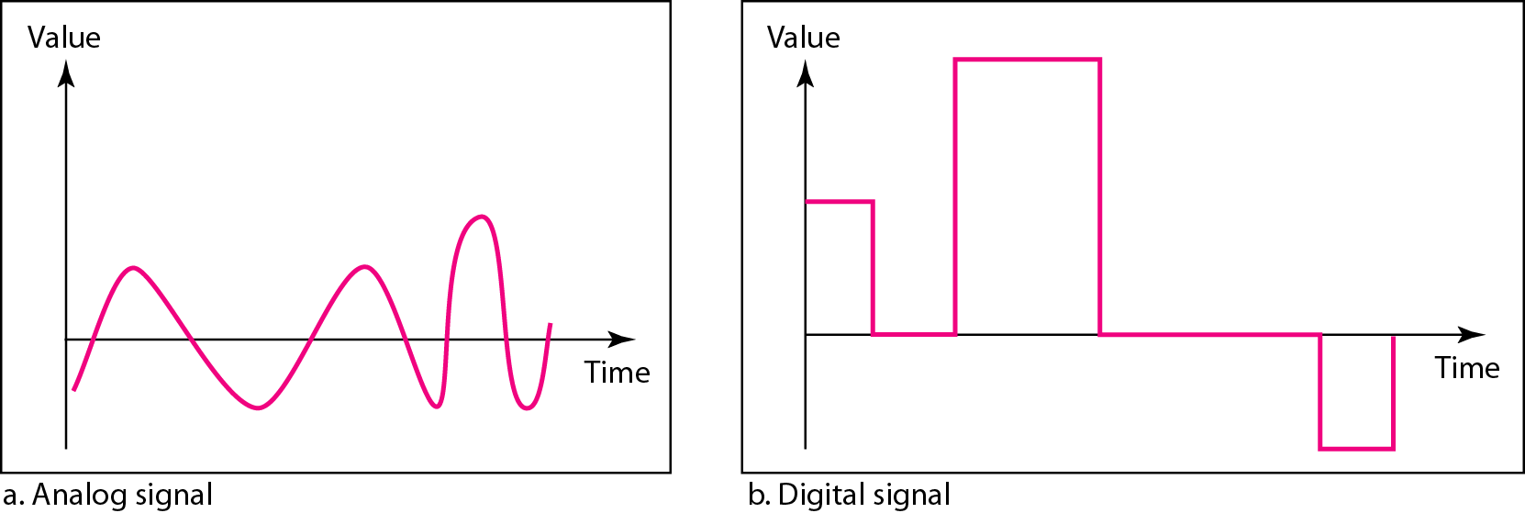
Figure: Comparison of analog and digital signals

Slide 6
2. Periodic analog signals
A signal is periodic when it completes a pattern within a measurable time frame called a period and repeats that pattern over subsequent identical periods.
A signal is nonperiodic signal changes without exhibiting a pattern or cycle that repeats over time.
Periodic analog signals can be classified as simple or composite. A simple periodic analog signal, a sine wave, cannot be decomposed into simpler signals. A composite periodic analog signal is composed of multiple sine waves.
A sine wave can be represented by three parameters: The peak amplitude, the frequency and the phase.
In data communications, we commonly use periodic analog signals and non periodic digital signals.

Slide 7
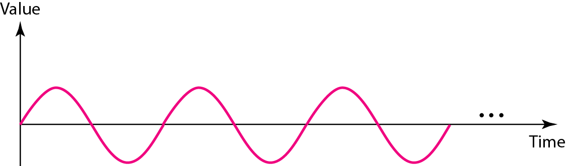
Figure: A sine wave

Slide 8

Peak Amplitude: It is the absolute value of its highest intensity ,propositional to the energy it carries. It is normally measured in volts.
Period: it is refers to the amount of time in seconds a signal needs to complete 1 cycle.
Frequency: It is refers to the number of period in 1s.
Frequency and period are the inverse of each other.
Phase:
It describes the position of the waveform relative to time 0
Phase is measured in degrees or radians.

Slide 9
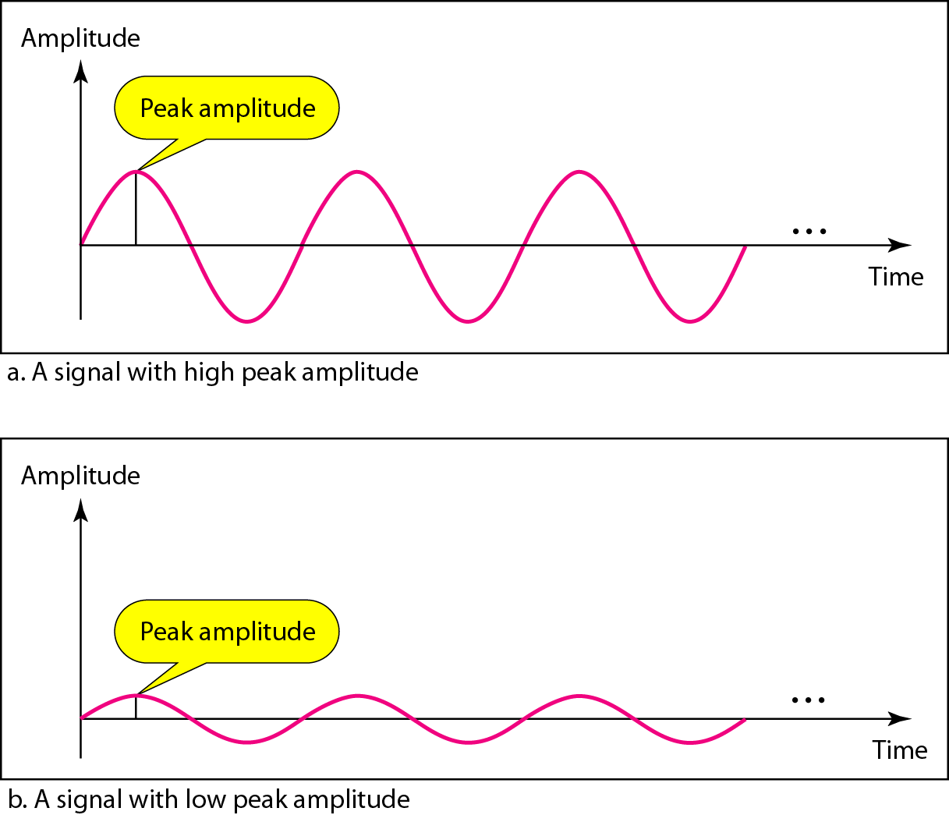
Figure: Two signals with the same phase and frequency, but different amplitudes

Slide 10
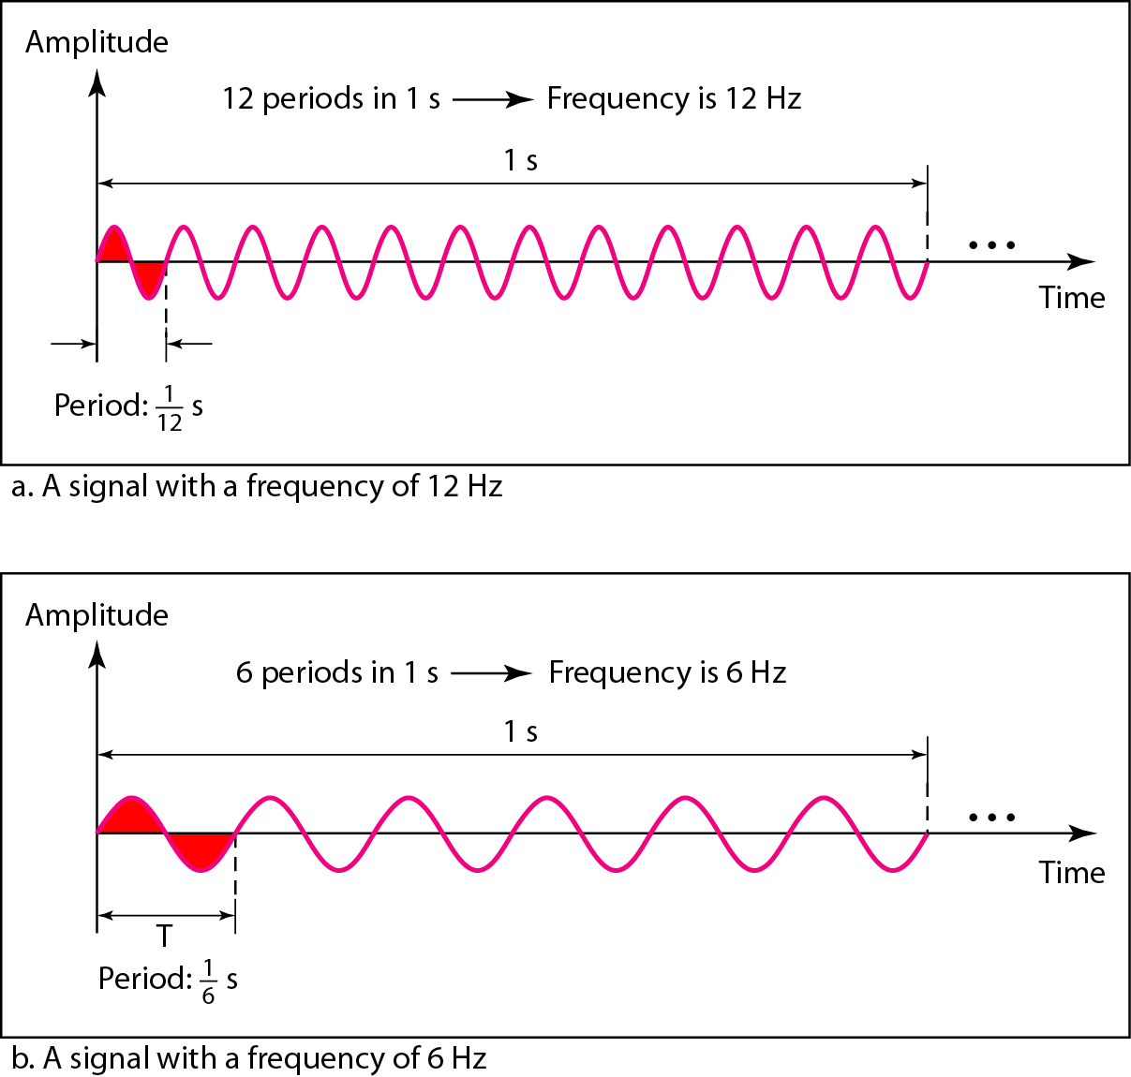
Figure: Two signals with the same amplitude and phase, but different frequencies

Slide 11
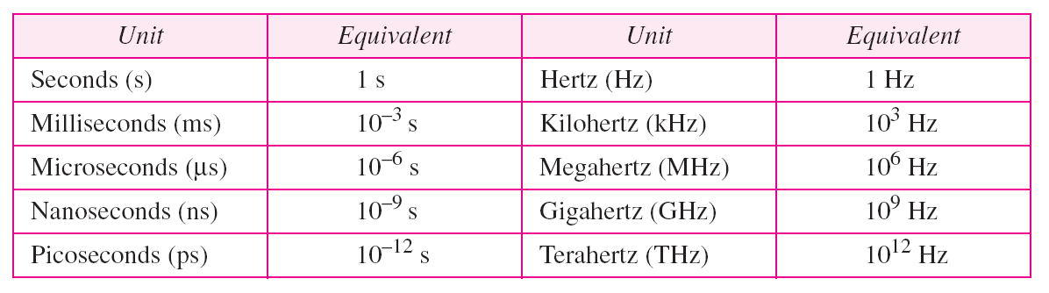
Table Units of period and frequency

Slide 12
Example
The power we use at home has a frequency of 60 Hz. The period of this sine wave can be determined as follows:

Slide 13
Example
Express a period of 100 ms in microseconds.
Solution
find the equivalents of 1 ms (1 ms is 10⁻³ s) and 1 s (1 s is 10⁶ μs). We make the following substitutions:.

Slide 14
Example
The period of a signal is 100 ms. What is its frequency in kilohertz?
Solution
First we change 100 ms to seconds, and then we calculate the frequency from the period (1 Hz = 10⁻³ kHz).

Slide 15
Frequency is the rate of change with respect to time. Change in a short span of time
means high frequency. Change over a long span of time means low frequency.

Slide 16
If a signal does not change at all, its frequency is zero.
If a signal changes instantaneously, its frequency is infinite.

Slide 17
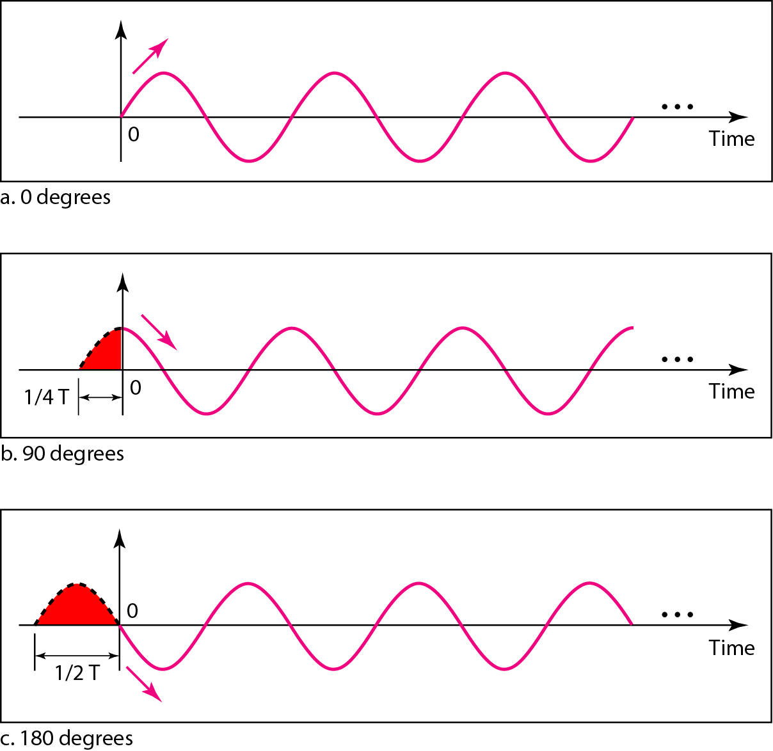
Figure Three sine waves with the same amplitude and frequency, but different phases

Slide 18
Example
A sine wave is offset 1/6 cycle with respect to time 0. What is its phase in degrees and radians?
Solution
We know that 1 complete cycle is 360°. Therefore, 1/6 cycle is
Radian = degree x π / 180

Slide 19
Wavelength:
It is another characteristic of a signal traveling through a transmission medium.
It binds the period or the frequency of a simple wave to the propagation speed of the medium.

Slide 20
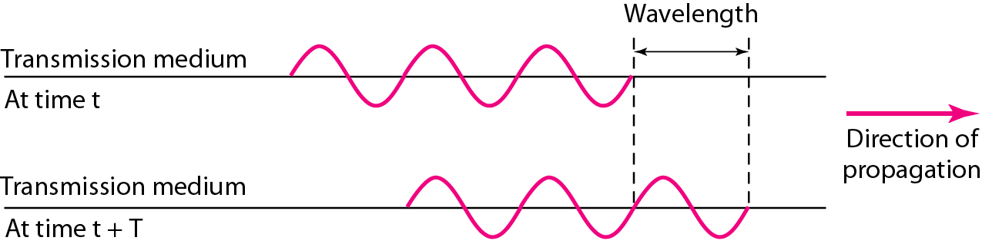
Figure Wavelength and period

Slide 21
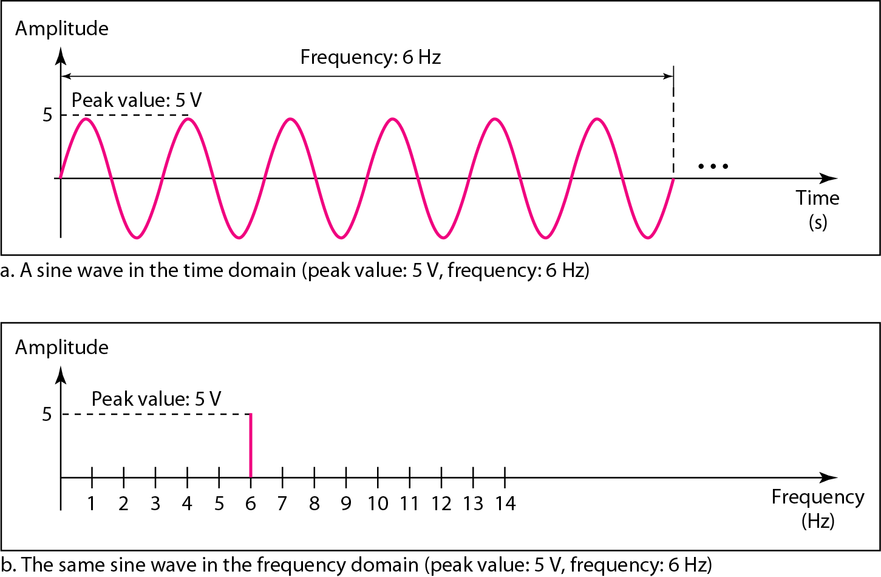
A complete sine wave in the time domain can be represented by one single spike in the frequency domain.
FigureThe time-domain and frequency-domain plots of a sine wave

Slide 22
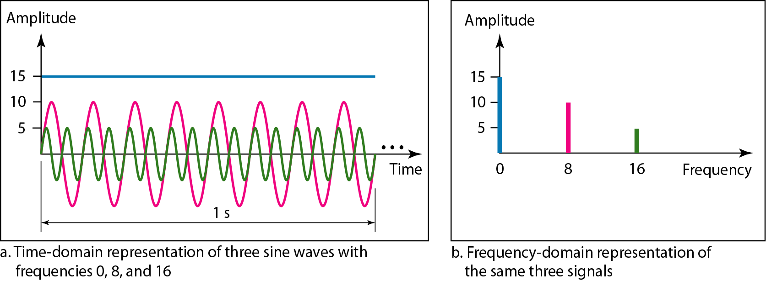
The frequency domain is more compact and useful when we are dealing with more than one sine wave.
For example, Figure shows three sine waves, each with different amplitude and frequency.
All can be represented by three spikes in the frequency domain.
Figure The time domain and frequency domain of three sine waves

Slide 23
Composite Periodic Signal
A single-frequency sine wave is not useful in data communications; we need to send a composite signal, a signal made of many simple sine waves.
According to Fourier analysis, any composite signal is a combination of simple sine waves with different frequencies, amplitudes, and phases.
If the composite signal is periodic, the decomposition gives a series of signals with discrete frequencies
If the composite signal is nonperiodic, the decomposition gives a combination of sine waves with continuous frequencies.

Slide 24
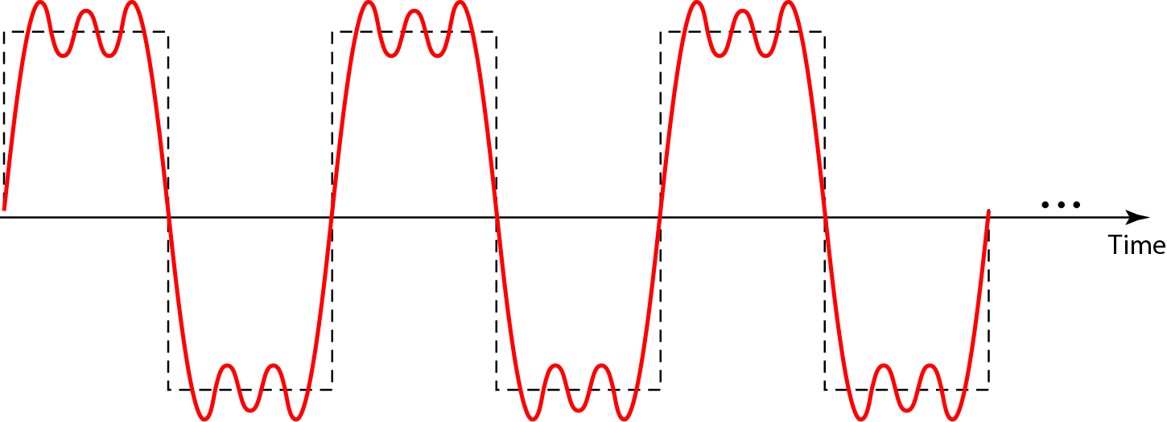
Figure A composite periodic signal

Slide 25
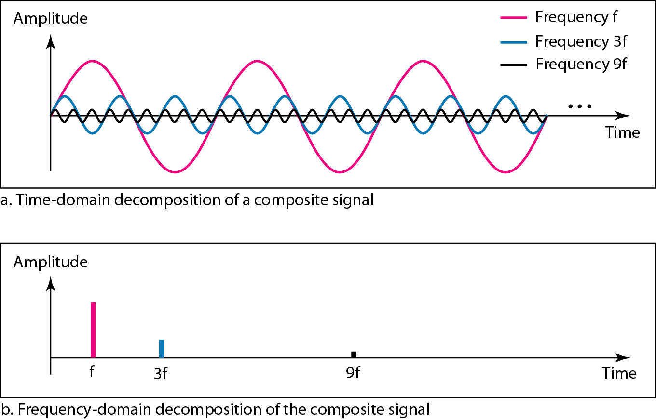
Figure Decomposition of a composite periodic signal in the time and frequency domains

Slide 26
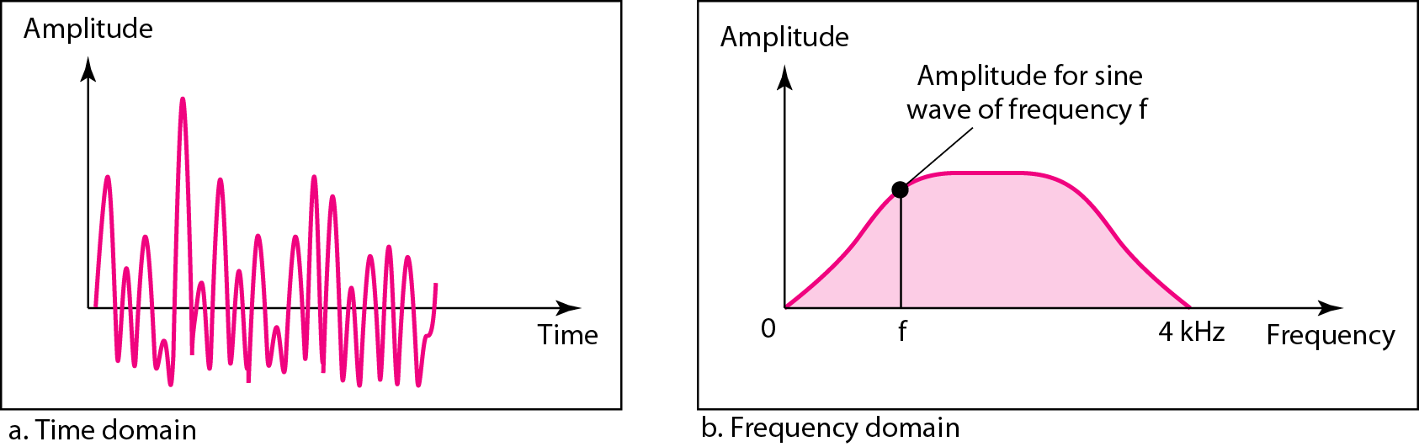
Figure The time and frequency domains of a nonperiodic signal

Slide 27
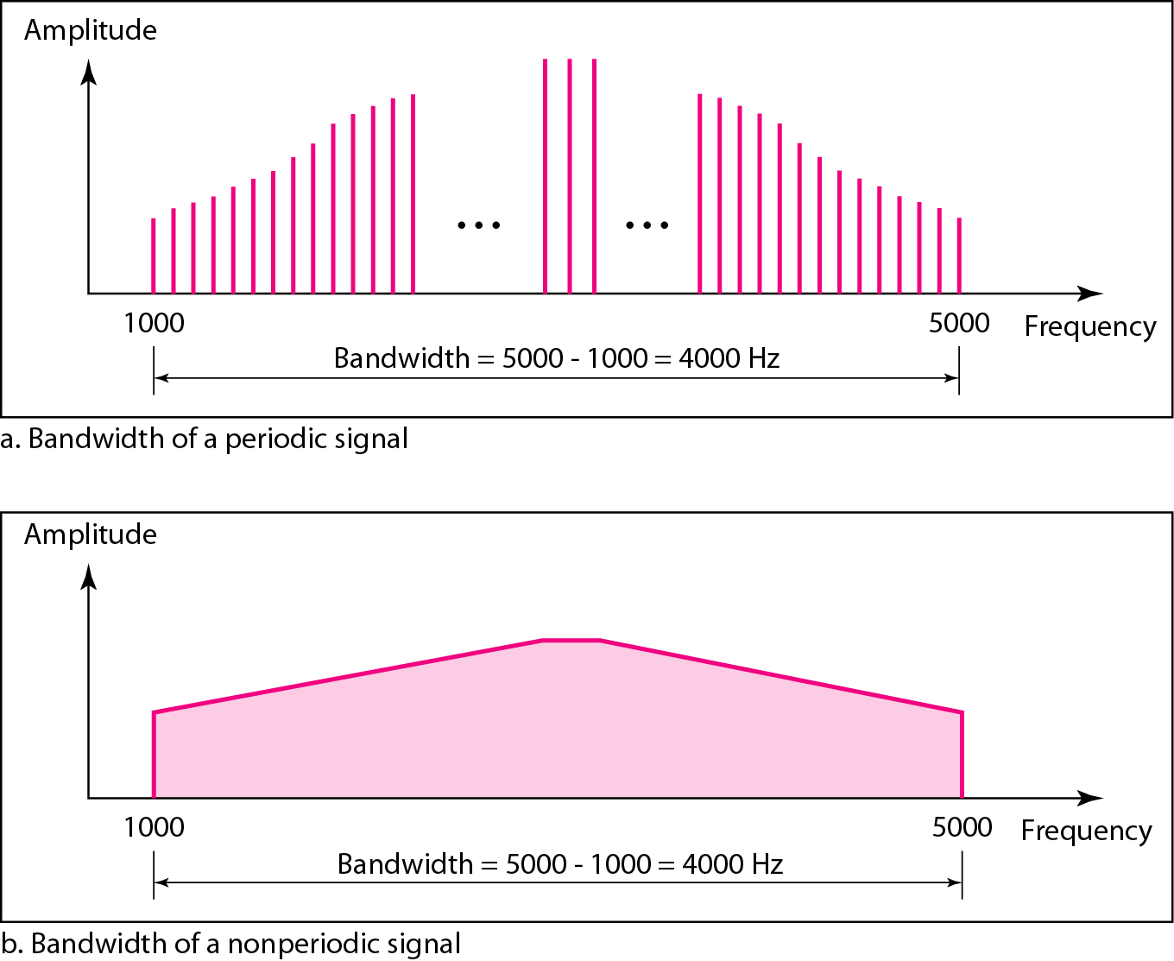
The bandwidth of a composite signal is the difference between the
highest and the lowest frequencies contained in that signal.
Figure The bandwidth of periodic and nonperiodic composite signals

Slide 28
Example
If a periodic signal is decomposed into five sine waves with frequencies of 100, 300, 500, 700, and 900 Hz, what is its bandwidth? Draw the spectrum, assuming all components have a maximum amplitude of 10 V.
Solution
Let f_{h} be the highest frequency, f_{l} the lowest frequency, and B the bandwidth. Then
The spectrum has only five spikes, at 100, 300, 500, 700, and 900 Hz (see Figure 3.13).

Slide 29
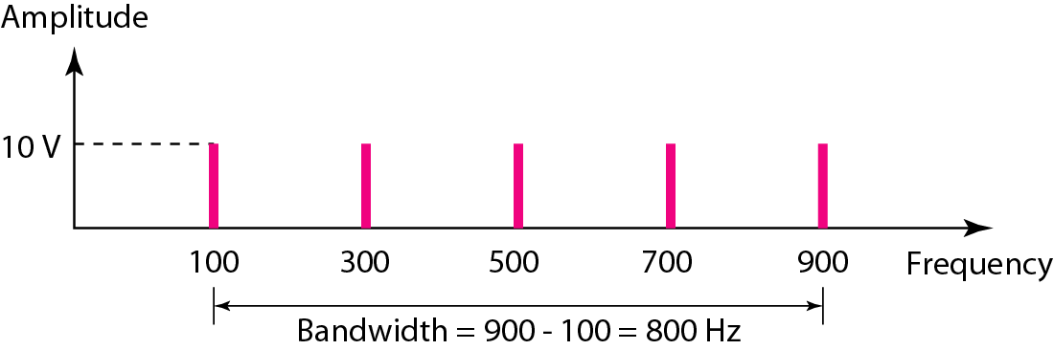
Figure The bandwidth

Slide 30
Example
A periodic signal has a bandwidth of 20 Hz. The highest frequency is 60 Hz. What is the lowest frequency? Draw the spectrum if the signal contains all frequencies of the same amplitude.
Solution
Let f_{h} be the highest frequency, f_{l} the lowest frequency, and B the bandwidth. Then
The spectrum contains all integer frequencies. We show this by a series of spikes (see Figure 3.14).

Slide 31
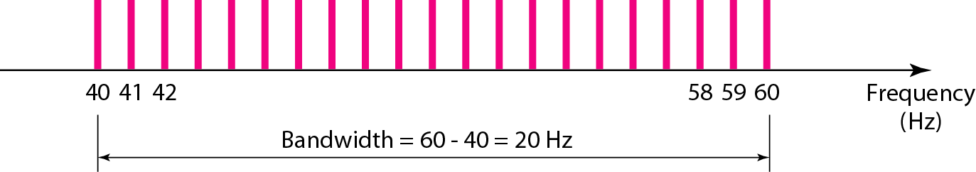
Figure The bandwidth

Slide 32
Example
A nonperiodic composite signal has a bandwidth of 200 kHz, with a middle frequency of 140 kHz and peak amplitude of 20 V. The two extreme frequencies have an amplitude of 0. Draw the frequency domain of the signal.
Solution
The lowest frequency must be at 40 kHz and the highest at 240 kHz. Figure 3.15 shows the frequency domain and the bandwidth.

Slide 33
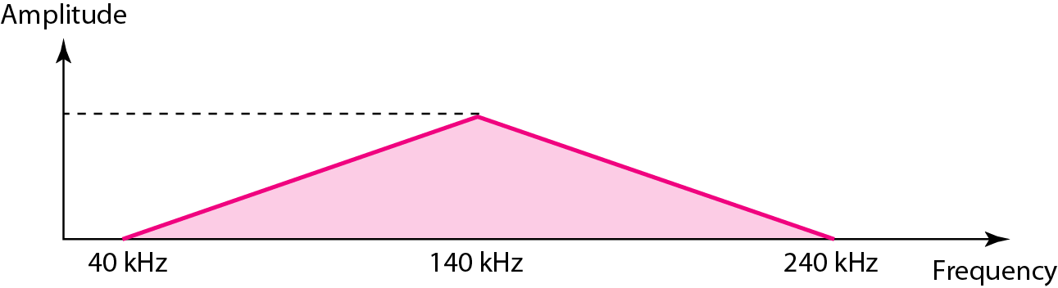
Figure The bandwidth

Slide 34
3. Digital Signals
A digital signal can have more than two levels.
In this case, we can send more than 1 bit for each level.
For example, a 1 can be encoded as a positive voltage and a 0 as zero voltage.
Bit rate is used here to describe the digital signal. It is the number of bits in 1s.
Bit length is the distance one bit occupies on the transmission medium(like wavalength).
Bit length = Propagation speed * bit duration

Slide 35
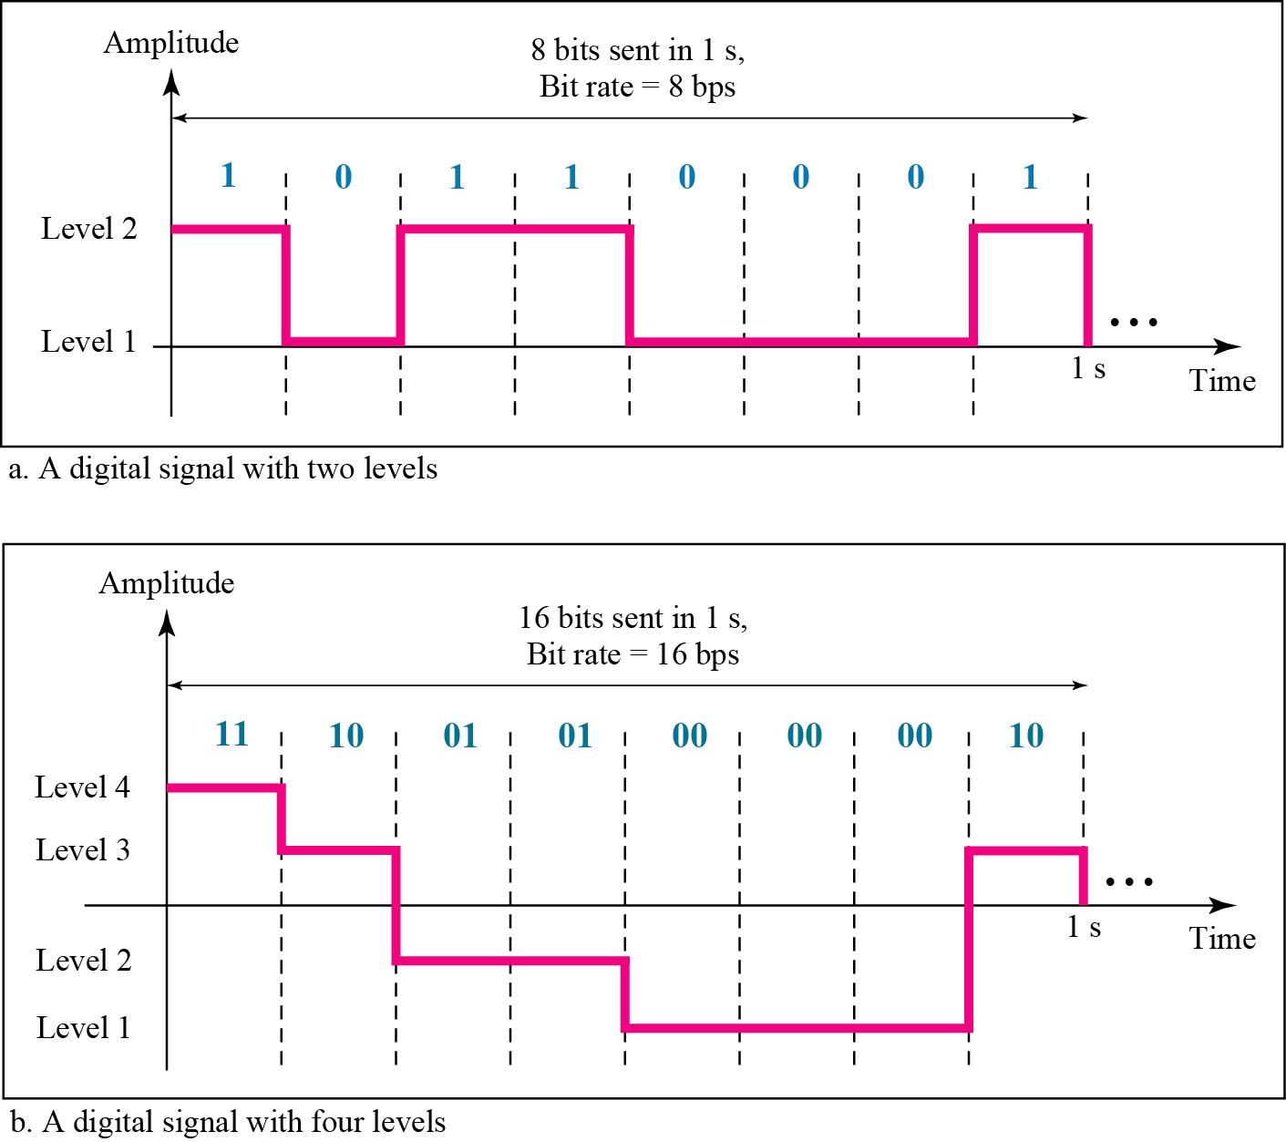
Figure Two digital signals: one with two signal levels and the other with four signal levels

Slide 36
Example
1) A digital signal has eight levels. How many bits are needed per level? We calculate the number of bits from the formula
Each signal level is represented by 3 bits.
2) A digital signal has nine levels. How many bits are needed per level? We calculate the number of bits by using the formula. Each signal level is represented by 3.17 bits. However, this answer is not realistic. The number of bits sent per level needs to be an integer as well as a power of 2. For this example, 4 bits can represent one level.

Slide 37
Example
Assume we need to download text documents at the rate of 100 pages per minute. What is the required bit rate of the channel?
Solution
A page is an average of 24 lines with 80 characters in each line. If we assume that one character requires 8 bits, the bit rate is

Slide 38
Example
A digitized voice channel, as we will see in Chapter 4, is made by digitizing a 4-kHz bandwidth analog voice signal. We need to sample the signal at twice the highest frequency (two samples per hertz). We assume that each sample requires 8 bits. What is the required bit rate?
Solution
The bit rate can be calculated as

Slide 39
Example
What is the bit rate for high-definition TV (HDTV)?
Solution
HDTV uses digital signals to broadcast high quality video signals. The HDTV screen is normally a ratio of 16 : 9. There are 1920 by 1080 pixels per screen, and the screen is renewed 30 times per second. Twenty-four bits represents one color pixel.
The TV stations reduce this rate to 20 to 40 Mbps through compression.

Slide 40
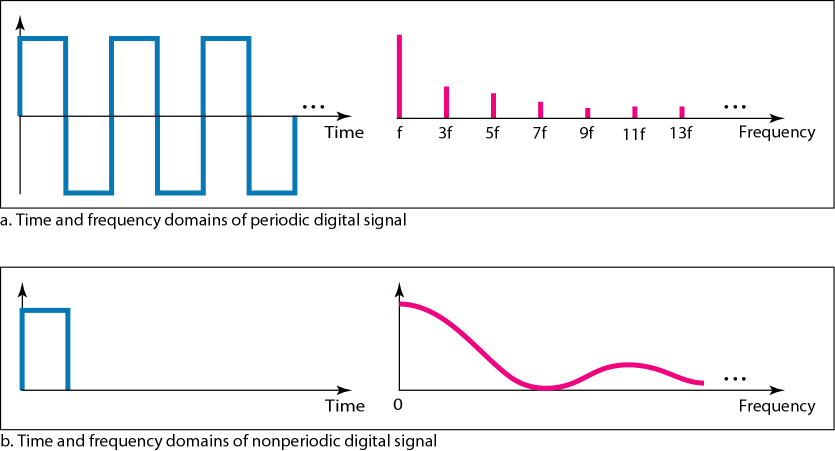
Figure The time and frequency domains of periodic and nonperiodic digital signals

Slide 41
Baseband Transmission
Baseband transmission means sending a digital signal over a channel without changing the digital signal to an analog signal.
A digital signal is a composite analog signal with an infinite bandwidth.
It requires that we have low-pass channel, a channel with a bandwidth that starts from zero.
Example two computer directly connected or bus communication only two computers active at a time.

Slide 42
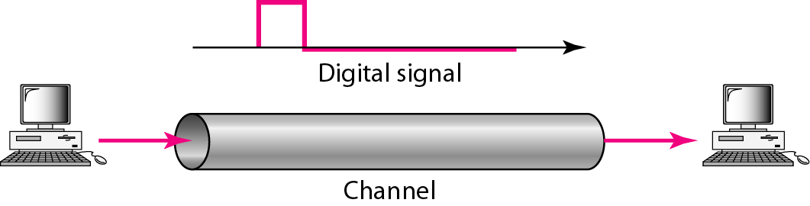
Figure Baseband transmission

Slide 43
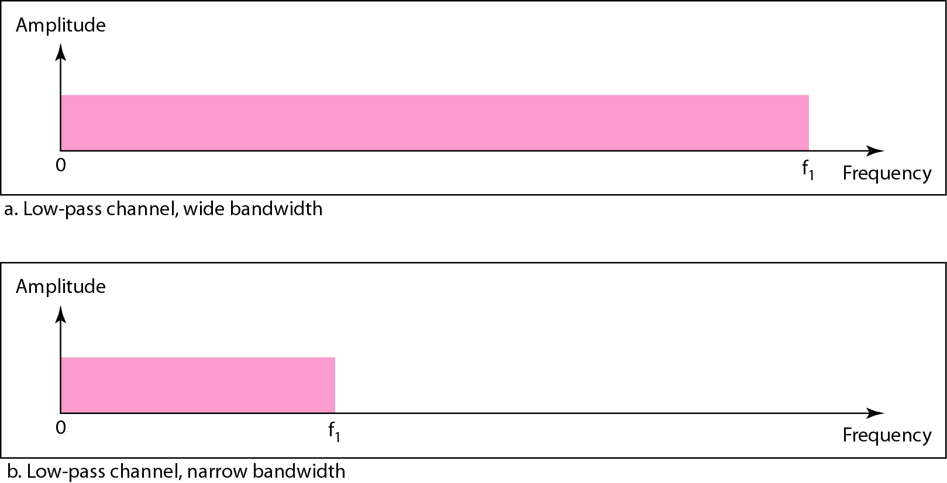
Figure Bandwidths of two low-pass channels

Slide 44
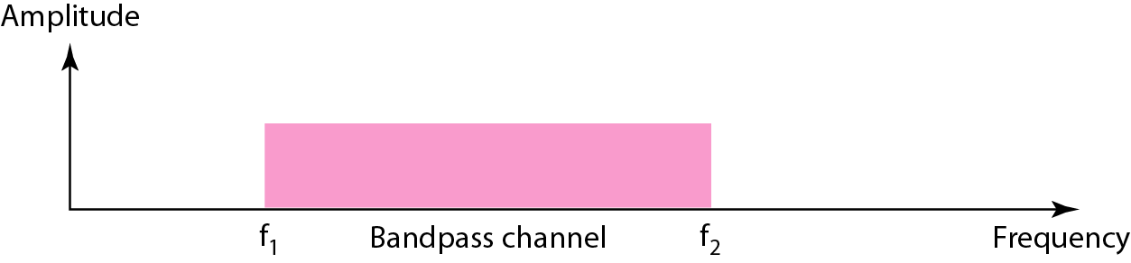
Figure Broadband transmission and Bandwidth of a bandpass channel
A bandwidth that doesnot start from zero.
low-pass channel can be considered a bandpass channel with the lower frequency starting at zero.
Modulation allows us to use a bandpass channel.
When channel is bandpass signal can not transmitted without converting from digital to analog.

Slide 45
Example
An example of broadband transmission using modulation is the sending of computer data through a telephone subscriber line, the line connecting a resident to the central telephone office. These lines are designed to carry voice with a limited bandwidth. The channel is considered a bandpass channel. We convert the digital signal from the computer to an analog signal, and send the analog signal. We can install two converters to change the digital signal to analog and vice versa at the receiving end. The converter, in this case, is called a modem.

Slide 46
4. TRANSMISSION IMPAIRMENT
Signals travel through transmission media, which are not perfect. The imperfection causes signal impairment. This means that the signal at the beginning of the medium is not the same as the signal at the end of the medium. What is sent is not what is received. Three causes of impairment are attenuation, distortion, and noise.

Slide 47
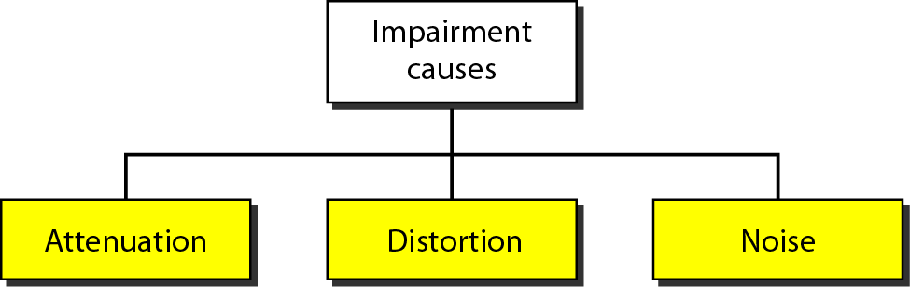
Figure Causes of impairment

Slide 48
Attenuation
- It means a loss of energy.
When signal travels through a medium, it loses some of its energy in overcoming the resistance of the medium.
Amplifier is used to amplify the signal.

Slide 49
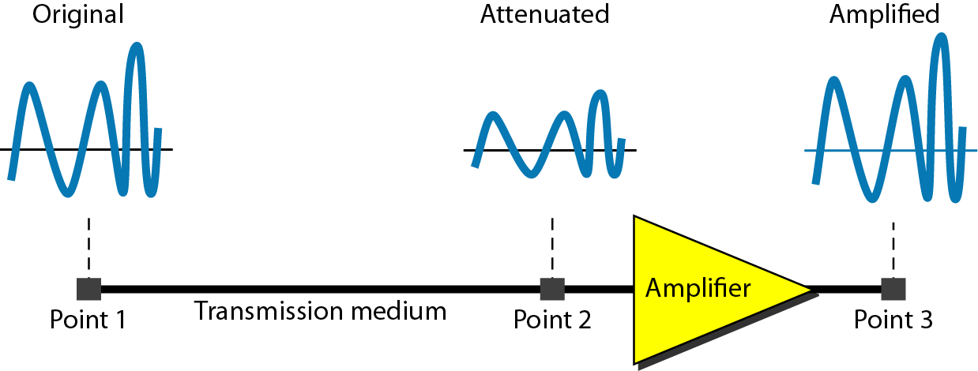
Figure Attenuation

Slide 50
Distortion
It means that the signal changes its form or shape.
It can occur in a composite signal made of different frequencies.

Slide 51
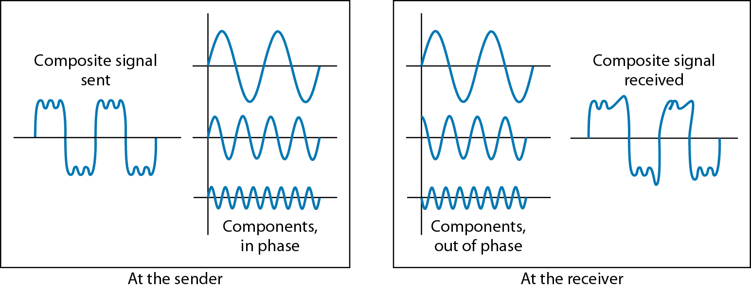
Figure Distortion

Slide 52
Noise
Noise is another cause of impairment.
It is due to thermal noise, induced noise, crosstalk and impulse noise.
Thermal noise is the random motion of electrons in a wire which creates and extra signal.
Induced noise comes from such as motors and appliances.
Crosstalk is the effect of the one wire on the other.,
Impulse noise is a spike(signal with high energy in a very short time) that comes from power lines, lightning.

Slide 53
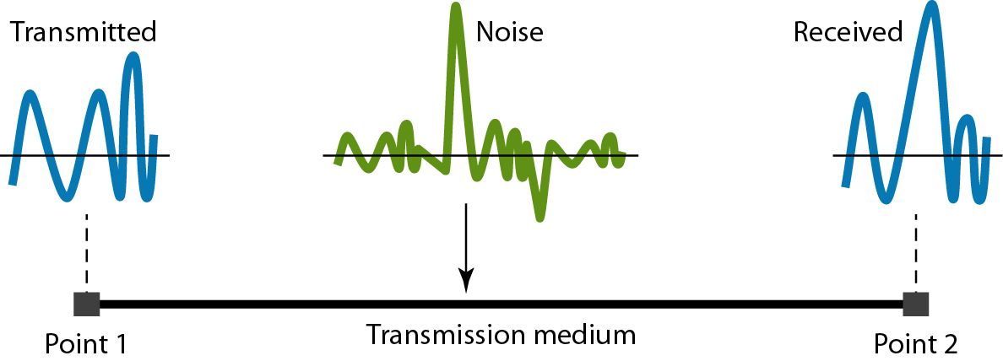
Figure Noise

Slide 54
Signal to noise ratio(SNR)
SNR is actually the ratio of what is wanted to what is not wanted
A high SNR means the signal is less corrupted by noise and a low SNR means the signal is more corrupted by noise.

Slide 55
5. Data rate limits
It means how fast we can send data in bit per second over a channel. It depends on following factors
The bandwidth available
The level of the signals we use
The quality of the channel.
Two way we can calculate the data rate by using Nyquist for a noiseless channel and using Shannon capacity for noisy channel.
Nyquist Bit rate = 2 * bandwidth * log2 L
Increasing the levels of a signal may reduce the reliability of the system.

Slide 56
It is impossible to have noiseless channel. So shannon capacity is used to determine the highest data rate for a noisy channel.
Capacity = bandwidth * log2(1+SNR)
Here in this formula there is no indication of signal level which means that no matter how many levels we have, we cannot achieve a data rate higher than the capacity of the channel.

Slide 57
Example
The power of a signal is 10 mW and the power of the noise is 1 μW; what are the values of SNR and SNR_{dB} ?
Solution
The values of SNR and SNRdB can be calculated as follows:

Slide 58
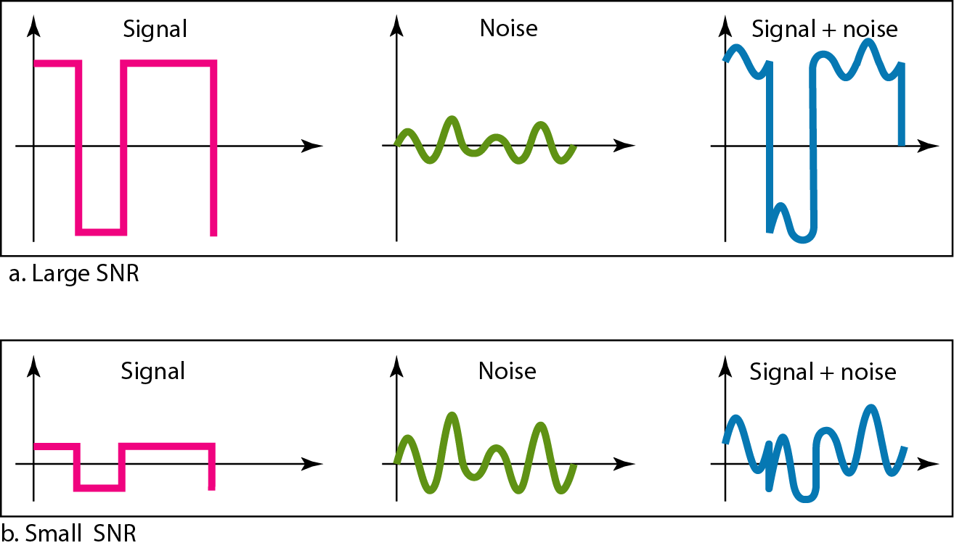
Figure Two cases of SNR: a high SNR and a low SNR

Slide 59

Example
A network with bandwidth of 10 Mbps can pass only an average of 12,000 frames per minute with each frame carrying an average of 10,000 bits. What is the throughput of this network?
Solution
We can calculate the throughput as
The throughput is almost one-fifth of the bandwidth in this case.

Slide 60
Example
What is the propagation time if the distance between the two points is 12,000 km? Assume the propagation speed to be 2.4 × 108 m/s in cable.
Solution
We can calculate the propagation time as
The example shows that a bit can go over the Atlantic Ocean in only 50 ms if there is a direct cable between the source and the destination.

Slide 61
Example
What are the propagation time and the transmission time for a 2.5-kbyte message (an e-mail) if the bandwidth of the network is 1 Gbps? Assume that the distance between the sender and the receiver is 12,000 km and that light travels at 2.4 × 108 m/s.
Solution
We can calculate the propagation and transmission time as shown on the next slide:

Slide 62
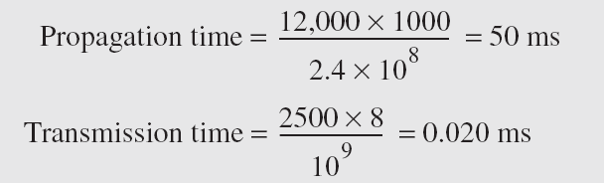
Example (continued)
Note that in this case, because the message is short and the bandwidth is high, the dominant factor is the propagation time, not the transmission time. The transmission time can be ignored.

Slide 63
Example
What are the propagation time and the transmission time for a 5-Mbyte message (an image) if the bandwidth of the network is 1 Mbps? Assume that the distance between the sender and the receiver is 12,000 km and that light travels at 2.4 × 10⁸ m/s.
Solution
We can calculate the propagation and transmission times as shown on the next slide.

Slide 64
Example(continued)
Note that in this case, because the message is very long and the bandwidth is not very high, the dominant factor is the transmission time, not the propagation time. The propagation time can be ignored.

Slide 65
Thank You

